Slide 1
VALEW – To VAlidate LEarning at Work
Final Meeting, Tallinn, 03 June 2010
Project Number: 147634-LLP-1-2008-1-IT-EQF - Grant Agreement: 2008 – 4521 / 001 - 001

Slide 2
Objectives
Study at European level the different approaches to the recognition and certification of competences developed in non formal – informal learning environments;
Find a common approach to recognize competences;
Highlight constraints/opportunities at local level and nationwide.

Slide 3
Focus
e-Competences related to the ICT sectors.
Soft skills.

Slide 4
The reference competence Frameworks
e-Competences: through the European e-Comptence Framework, developed with the help of the main companies operating in Europe and worldwide (both IT providers and end-users) together with experts nominated by the CEN/ISSS e-Skills Workshop (supported by the European Commission – DG Enterprise) and universities;
www.ecompetences.eu – CEN/ISSS eSkills Workshop and DG Enterprise.
Soft skills: through the DOSY Framework, developed by SCIENTER in a previous European project.

Slide 5
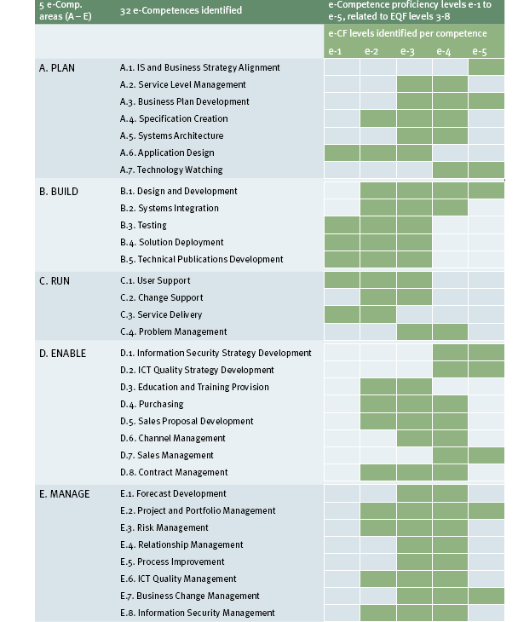
The e-CF in brief

Slide 6
The Dosy in brief (Abstract)

Slide 7
Main findings from the initial survey (in brief)
In The UK, recognition is mainly based on “observation” of candidates during the job. Specific stage sessions are planned also for adult people with paid subsistence costs);
In The Netherlands, the focus is mainly on “valuation” of skills instead of their “evaluation”, mainly on skills developed in voluntary services. Hence they use coaching, mentoring, counseling, to help candidates “rise awareness” of their capacities. The recognition process is quite close to that one being implemented in Italy;
In Estonia, occupational standards have been developed strongly linked to training and learning standards (a big challenge)
In Spain there is not a high formalization level of the process yet;

Slide 8
Main findings from the initial survey (in brief)
In Germany an approach on certification of competences at work has been developed through the ”AITTS- the Advanced IT Training System”; it plans an on the job training path lasting about 2 years, where candidates can learn new competences to be certified at the end of the process
In France Validation d’Acquis de l’Experience (Vae) has been exploited with the support of accredited Institutions by Ministry of Labour, Universities and enterprises. Sometimes candidates have to improve by training measures weak learning areas before receiving a qualification.

Slide 9
In Italy
Toscana, Emilia Romagna, Lombardy Region, have developed a Framework of professional/occupational standards; against those Frameworks (different from Region to Region ☺) it is possible to recognize competences. The process includes a) construction/collection of evidence, b) tutor/coach support, c) final assessment, d)certification issue.
Accordingly, it is focused on
    Competences (not on job roles/profiles);
    Awareness process of one’s own competences, moving from tacit to explicit knowledge (It is not a “traditional” learning path);
It lasts about 3 months: it depends on the effort of building or gathering evidence

Slide 10
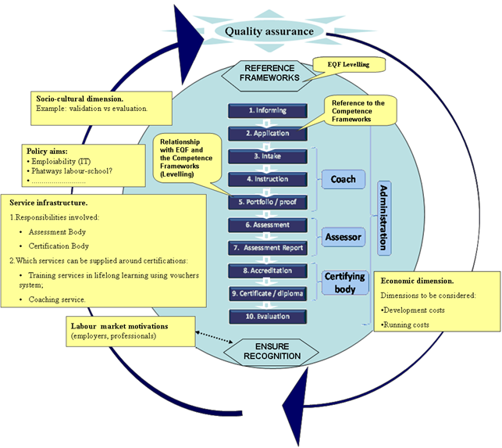
The VALEW model

Slide 11
Readiness index
 | POTENTIAL USERS (INDIVIDUALS) | EMPLOYERS | STAKEHOLDERS | (POLICY-MAKERS)
Need Perceived
Awareness of possible solutions
Willingness to commit
Willingness to pay
Existing of professional capacity in the system
Actual use
Legislative/Regulation Conditions
Qualification Framework in place

Slide 12
Some tools
Guidelines for evidence collection/building (making competence explicit)
Guidelines to evaluate evidence also trough EQF indicators
Guidelines for the final assessment (at present a face to face interview only)
……

Slide 13
Making competence explicit
Recognition of competence (fill in the name of the competence):____________________
ABSTRACT

Slide 14
Evidence assessment grid linked to EQF indicators
GRIGLIA DI VALUTAZIONE DELLE EVIDENZE / EVIDENCE ASSESSMENT GRID
Competenza:………… Competence:………… | Evidence 1 | Evidence 2 | Evidence 3 | … | Evidence n | Total Score | Assessment * | Note
Complessità del contesto (dei progetti, processi, attività descritte nelle evidenze) Context Complexity (of projects, processes, activities described in the evidence) | 1 | 0 |  |  | 0,5 | 1,5
Tipologia di attività/problemi da affrontare (nuovi; applicativi, teorici) Tipology of activities/problems to be solved (new, pactical, theoretical activities/problems) |  | 1 |  |  | 0 | 1
Livello di Autonomia Autonomy |  |  | 1 |  |  | 1
Presidio dei cambiamenti (presenza; prevedibilità, imprevedibilità) Change Management (currently; predictability; unpredictability)
Livello di responsabilità /attività personali; svolte da altri) Responsibilities (personal; managerial responsibilities) |  | 0,5 | 1 |  |  | 0
Livello di consapevolezza Competence Awareness
Tipologia/ampiezza di conoscenza (specialistica; “fattuale”; teorica) Tipology/breadth of knowledge (specialized, practical, theoretical)
 |  |  |  |  |  |  | *Fully satisfied/Medium satisfied/No satisfied)

Slide 15
Assessment grid (for face to face interviews)
 | ASSESSMENT IN PRESENZA / ASSESSMENT GRID
 | Comprensione del problema Comprehension of a problem | Competenze metodologiche Methodological Skills | Competenzespecifiche Specific Skills | Padronanza del linguaggio tecnico Mastery of Technical Language (optional) | Punteggio totale Total Score
Competenza:…… Competence:……
Note | Inserire qui il contenuto delle domande ed eventuali annotazioni e/o considerazioni tuili alla formulazione del giudizio finale. Enter here notes, questions and/or considerations for the Final Result.

Slide 16

The testing phase:
Meetings/focus groups addressed to potential candidates, companies and Institutions
Questionnaires addressed to companies and institutions
Volunteer candidates to be “certified”

Slide 17
Meetings - Input questions to potential candidates (only first input suggestions)
Do you feel the need of a system for recognition and validation of competences acquired during the job (or in other contexts different from school)? If yes, why?
How would you like to use such certification? What would you expect from Institutions? Would you pay the service?
What kind of competences would you like to certificate?
Would you be able to describe your competences (what you are “able to do”)? Do you think to need an external support for this process?

Slide 18
Meetings - Input questions to potential candidates
How would you imagine the recognition/validation process?
What kind of evidence would you bring to show your competence? How long would you take to prepare such pieces of evidence?
Would you like to be helped by experts (e.g. tutor/coaches)? If yes, would you prefer experts of learning processes or specific contents?
Would you pay such service?

Slide 19
Meetings- Input questions to companies
Could such approach work in your company? Where?/in which contexts? For which objectives?
E.g for stage and apprenticeship
Is there someone interested in experimenting the model and the tools?
---

Slide 20
Meetings - Input questions to political Institutions (from the readiness index)
What needs could meet this approach?
What actors should be involved? How?
What impact can have such approach?
Who can finance these activities?
Is the system ready in terms of capacities and competences?
How/for what will it be used ?
Legal conditions
Are standards and frameworks consistent?

Slide 21
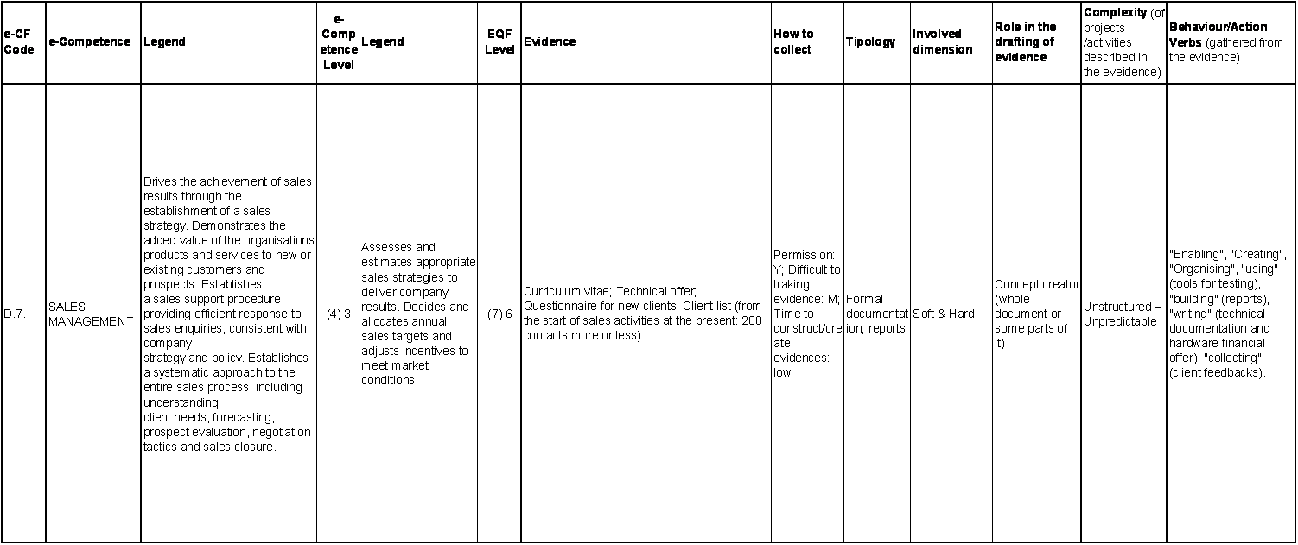
Certification process – collecting evidence – e-Competences

Slide 22
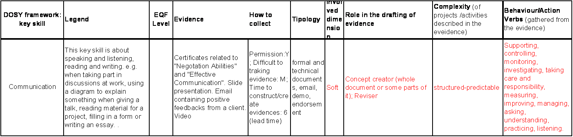
Certification process – collecting evidence – Soft skills

Slide 23
Thank you !
Angela Giordano
HR Project Promotion and Development
Project Manager
Fondazione Politecnico di Milano
Piazza Leonardo, 32
20133 Milano – I
+39 02 2399 9169
Angela.Giordano@fondazione.polimi.it
Clementina Marinoni
HR Project Promotion and Development
Head of Unit
Fondazione Politecnico di Milano
Piazza Leonardo, 32
20133 Milano – I
+39 02 2399 9168
Clementina.Marinoni@fondazione.polimi.it

